Slide 1
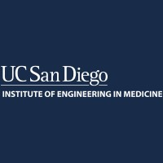
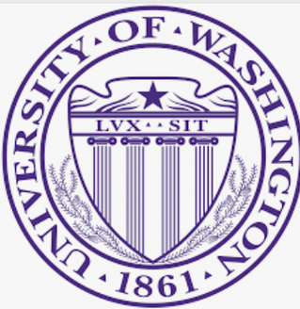
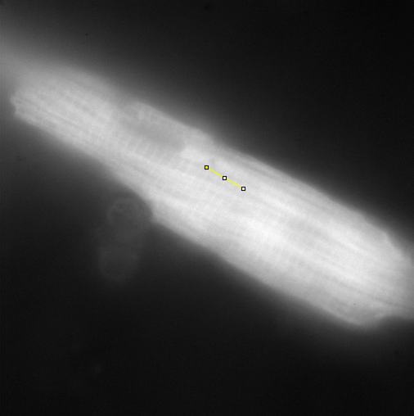
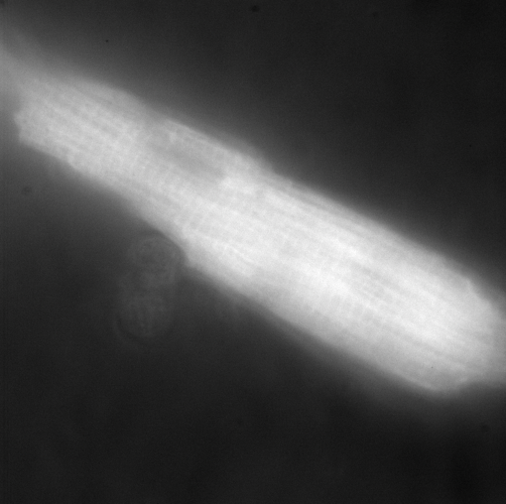

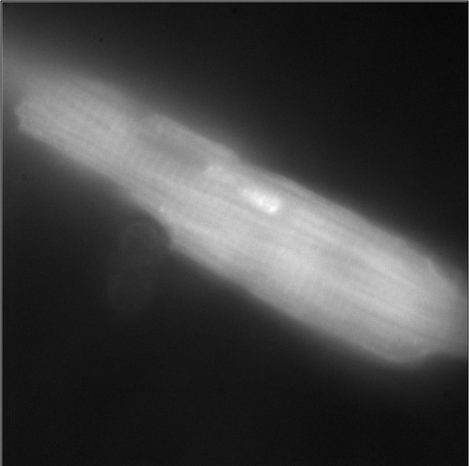
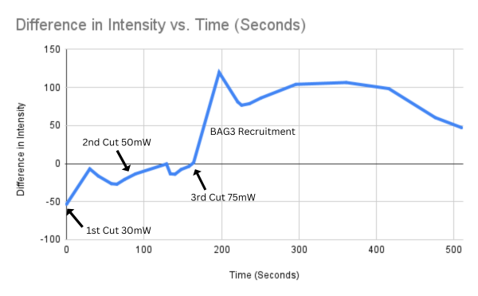
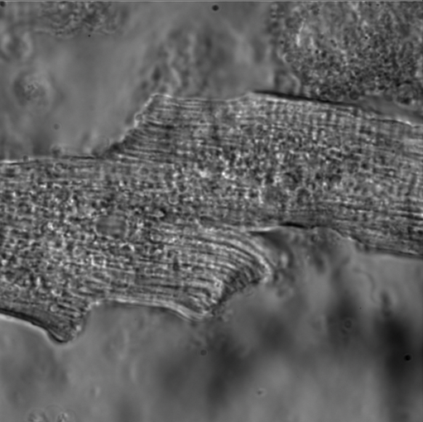
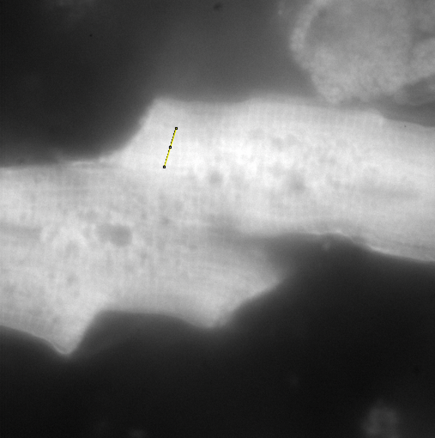
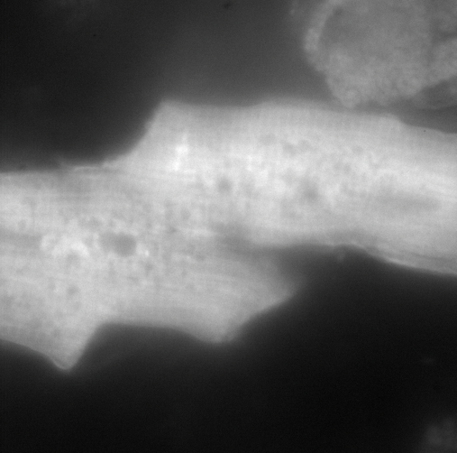
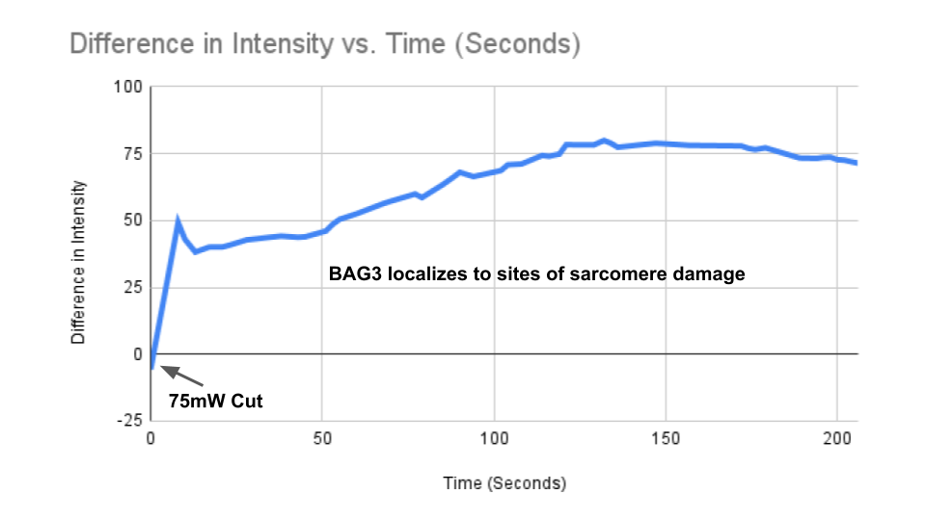
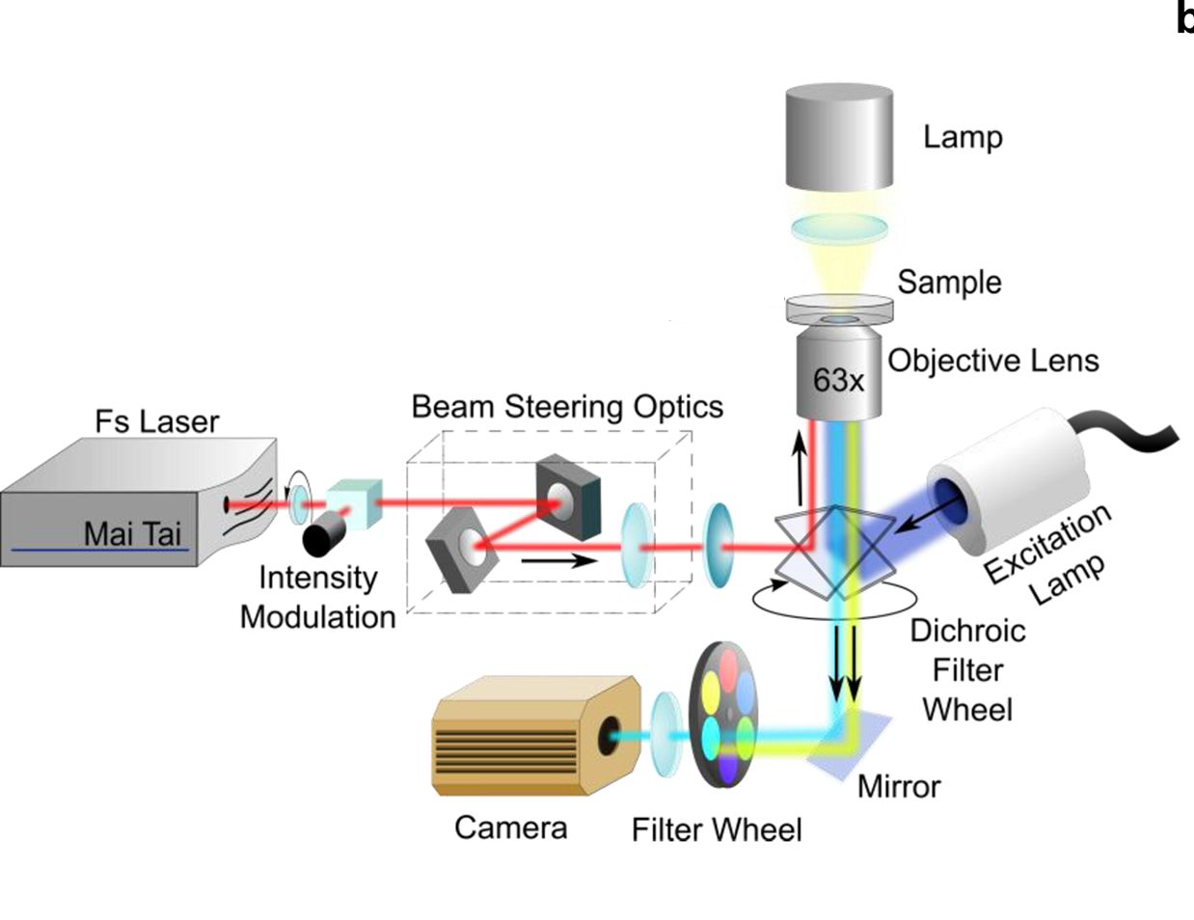
Studying Z-disk Maintenance and Sarcomere Repair in the Heart Using Laser Ablation Technique
Linda Shi¹, Suo Qin¹, Liuqing Chen¹, Veronica Gomez¹, Tsui-Min Wang², Andrew D. McCulloch¹,², Wei Feng³, Ju Chen³ and Joseph D. Powers²,⁴,⁵
¹Inistitute of Engineering in Medicine, University of California, San Diego, CA, ²Department of Bioengineering, University of California, San Diego, CA, ³Department of Medicine, University of California, San Diego, CA
⁴Department of Lab Medicine & Pathology, University of Washington, Seattle WA, ⁵Department of Mechanical Engineering, University of Washington, Seattle WA
INTRODUCTION
RESULTS AND DISCUSSIONS
Filamin C (FLNC) is a muscle-specific cytoskeletal protein that plays a critical role in the Z-disk of the sarcomere by interacting with numerous proteins. Notably, over 100 FLNC variants have been linked to human cardiomyopathies and heart failure. One common characteristic of FLNC-associated heart diseases is the disruption of Z-disk structure and interconnectivity, which likely contributes to the impaired contractility observed in these hearts. However, the understanding of FLNC's role in regulating the structure and function of adult mammalian hearts, as well as its involvement in cardiomyopathies, remains limited. Recent studies have revealed an interaction between FLNC and the Z-disk protein BAG3. BAG3 is known to be crucial for maintaining the structural integrity of the Z-disk and controlling FLNC production and degradation in the heart. Based on this knowledge, we propose the hypothesis that the interaction between BAG3 and FLNC plays a pivotal role in preserving the structural stability of the Z-disk. The objective is to investigate the dependence of the BAG3-FLNC interaction on Z-disk maintenance and the repair of sarcomere damage in cardiomyocytes. By elucidating the mechanisms underlying the BAG3-FLNC interaction and its impact on Z-disk stability, this research aims to provide valuable insights into the pathogenesis of FLNC-associated cardiomyopathies. Ultimately, this knowledge may open new avenues for developing therapeutic strategies to mitigate the structural and functional defects observed in these cardiac disorders.
No discernible recruitment was observed at the site of sarcomere damage when employing laser powers of 30mW and 50mW. Subsequently, upon applying a power of 75mW, BAG3 relocated to the site of ablation, resulting in a surge in intensity. This indicates that the BAG3 recruitment only occurs when the ablation surpasses the damage threshold, as demonstrated in Figure 2
(a) pre-cut at 30mW
(b) post-cut at 30mW
(c) post-cut at 50mW
(d) post-cut at 75mW
(e) intensity vs. time graph
Figure 2. Mouse ventricular cardiomyocyte before and after laser ablation at 30mW, 50mW, and 75mW.
During the experiments, the focused laser beam ablated the specific regions (single myofibrils and/or Z-disks) in living cardiomyocytes without causing cell death. BAG3 rapidly localized to sites of sarcomere damage, as shown in Figure 3.
MATERIALS AND METHODS
The GFP-tagged BAG3 mouse line was employed to track the kinetics of BAG3 in living cardiomyocytes isolated from the ventricles of adult mice. To induce targeted damage to the Z-disk and sarcomeres, a femtosecond pulsed laser beam was precisely focused on a small region of the live cardiomyocytes using a robotic laser microscope system. Subsequently, images were captured before and after the induced damage to quantify the dynamics of GFP-BAG3 during the repair process.
(a) phase image
(b) pre-cut GFP
(c) post-cut GFP
(d) intensity vs. time graph
Figure 3. Adult mouse ventricular cardiomyocyte expressing GFP-BAG3 before and after laser ablation at 75mW.
CONCLUSION & FUTURE WORK
The preliminary study shows the promising feasibility of laser-ablating single Z-disks and single sarcomeres in live cardiomyocytes to investigate protein dynamics during the repair process. Future studies will include knocking down FLNC in cardiomyocytes expressing GFP-BAG3 to determine how a loss of FLNC-BAG3 interaction affects BAG3-mediated sarcomere and Z-disk damage repair processes.
ACKNOWLEDGEMENTS & REFERENCES
Thank You
Figure 1 Robotic Laser Microscope System
(ACS Photonics, 2018)

